Slide 1
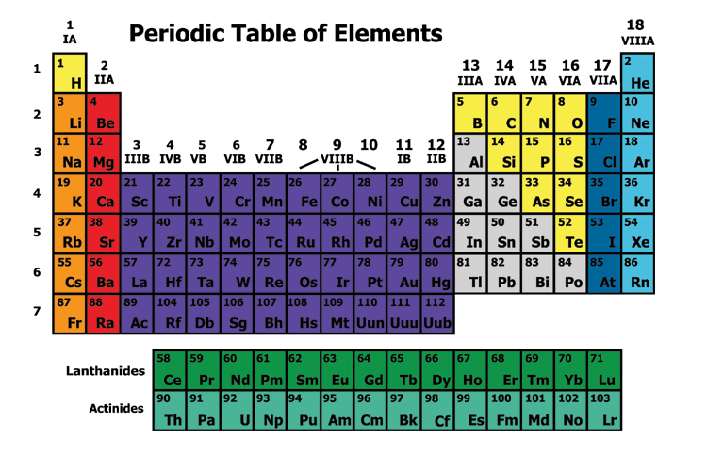

Slide 2
Elements are arranged:
Vertically into Groups
Horizontally Into Periods

Slide 3
Why?

Slide 4
If you looked at one atom of every element in a group you would see…

Slide 5
Each atom has the same number of electrons in it’s outermost shell.
An example…

Slide 6
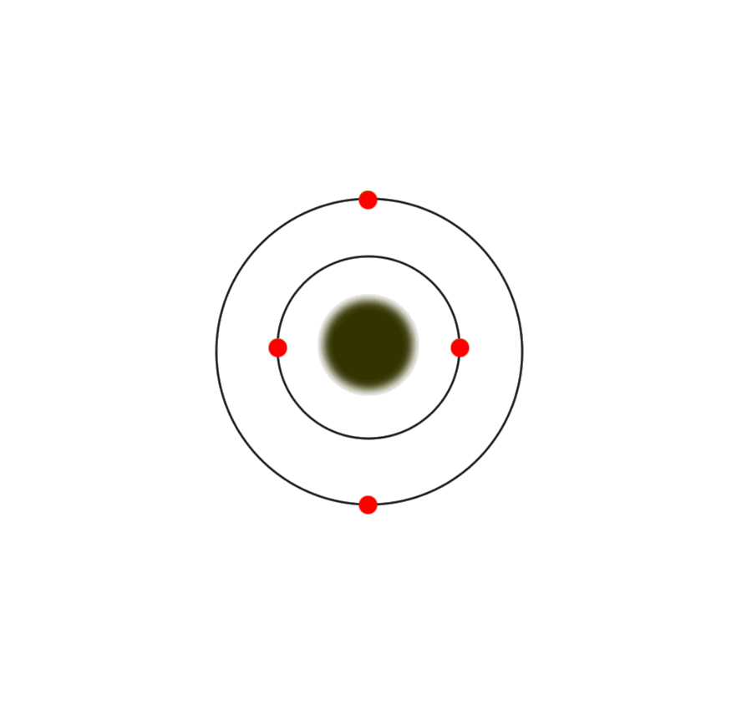
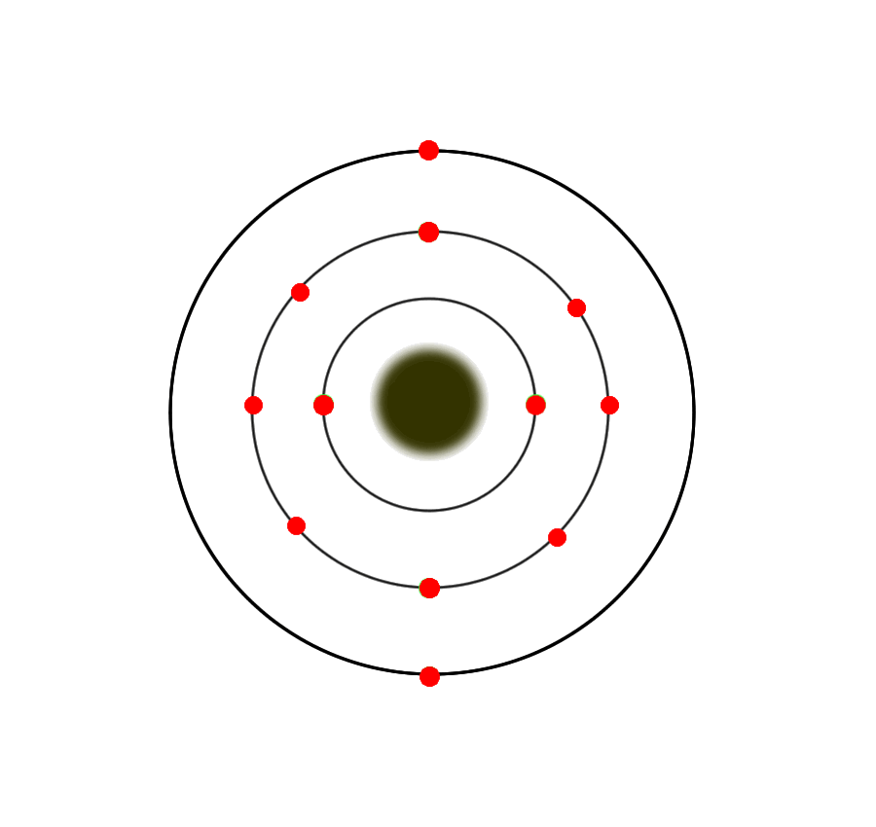
The group 2 atoms all have 2 electrons in their outer shells
Be (Beryllium)
Atom
Mg (Magnesium) Atom

Slide 7
The number of outer or “valence” electrons in an atom effects the way an atom bonds.
The way an atom bonds determines many properties of the element.
This is why elements within a group usually have similar properties.

Slide 8
If you looked at an atom from each element in a period
you would see…

Slide 9
Each atom has the same number of electron holding shells.
An example…

Slide 10
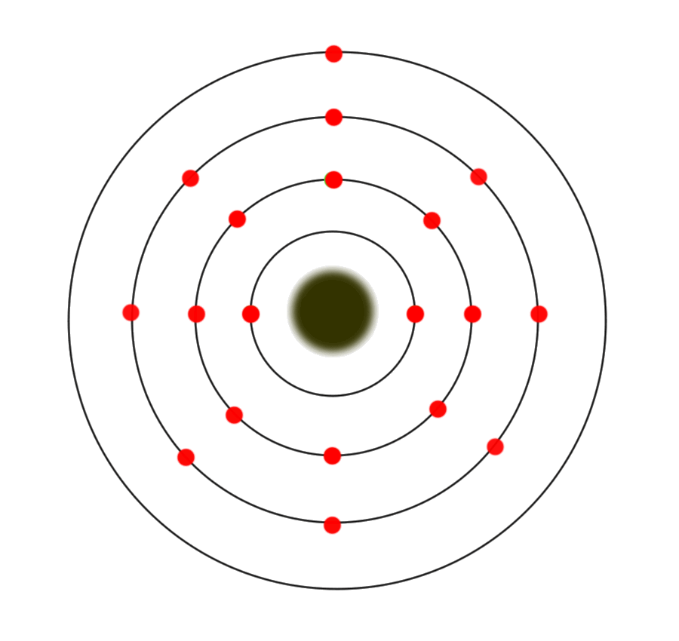
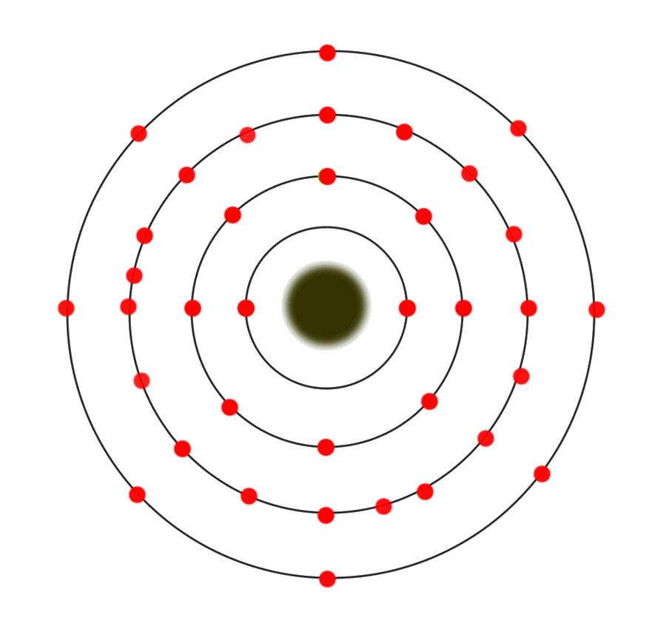
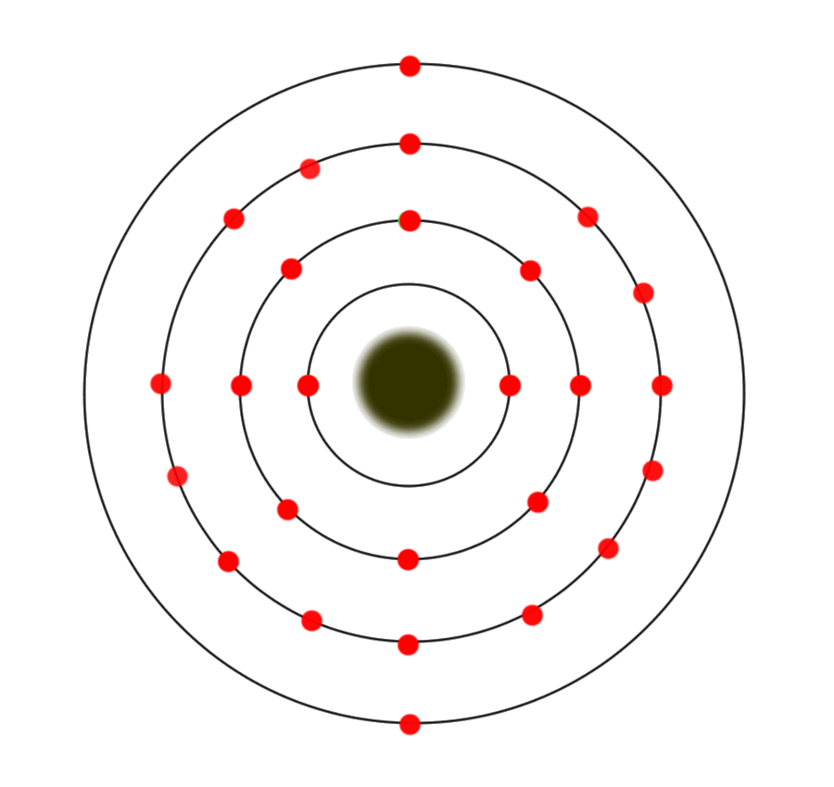
The period 4 atoms each have 4 electron containing shells
4th Shell
K (Potassium)
Atom
Kr (Krypton)
Atom
Fe (Iron) Atom

Slide 11
Each group has distinct properties
The periodic Table is divided into several groups based on the properties of different atoms.

Slide 12
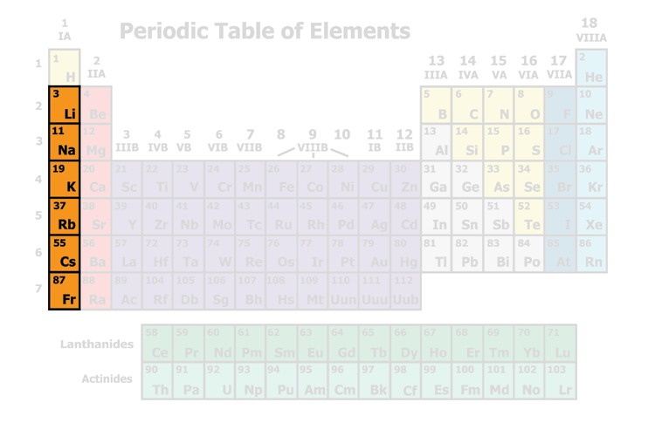
http://www.lyon.edu/webdata/Users/DMcDowell/GenChem/alkalishow.html
Alkali Metals
Soft, silvery colored metals
Very reactive!!!

Slide 13
Alkali Metals reacting with water:
Li (Lithium)
Na (Sodium)
K (Potassium)
Rb (Rubidium)
Cs (Cesium)
What would you expect from Francium?!?!

Slide 14
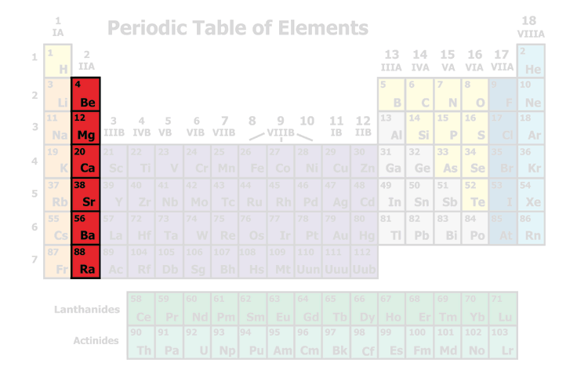
Alkaline Earth Metals
Silvery-White Metals
Fairly reactive
Many are found in rocks in the earth’s crust

Slide 15
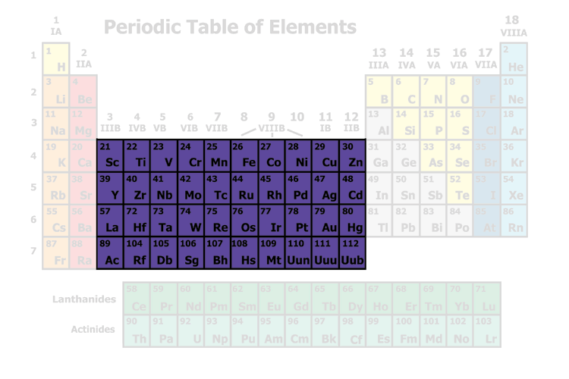
Transition Metals
Most are good Conductors of electricity
Malleable (easily bent/hammered into wires or sheets)

Slide 16
How many things can you think of that have Transition Metals in them?

Slide 17
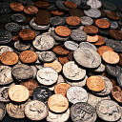
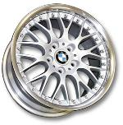
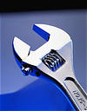
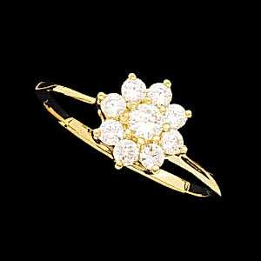

Slide 18
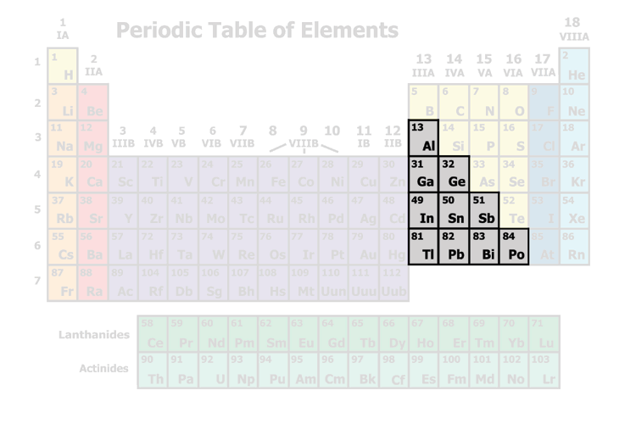
Metalloids lie on either side of these “stairsteps”
They share properties with both metals and non-metals
Si (Silicon) and Ge (Germanium) are very important “semi-conductors”

Slide 19
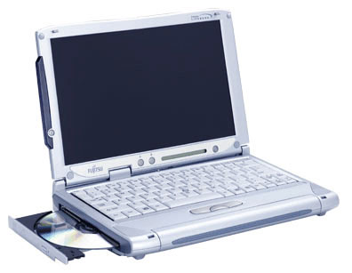
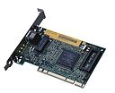
What are semiconductors used in?

Slide 20
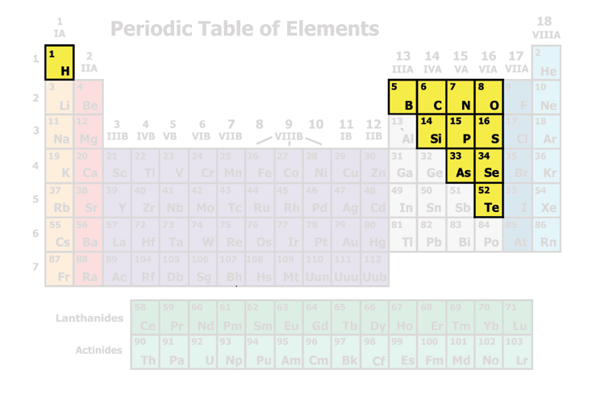
Nonmetals
Brittle
Do not conduct electricity

Slide 21
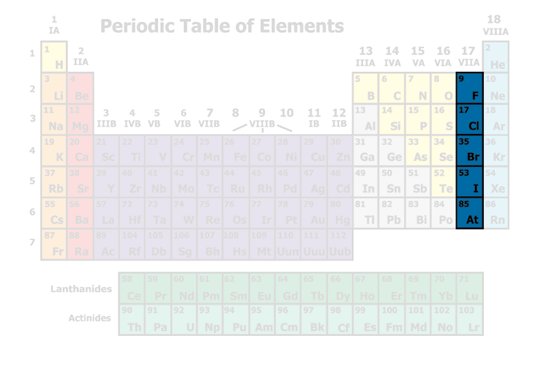
Halogens
Most are Poisonous
Fairly reactive

Slide 22
Chlorine Gas was used as a chemical weapon during World War I.
It was used by the Nazis in World War II.

Slide 23
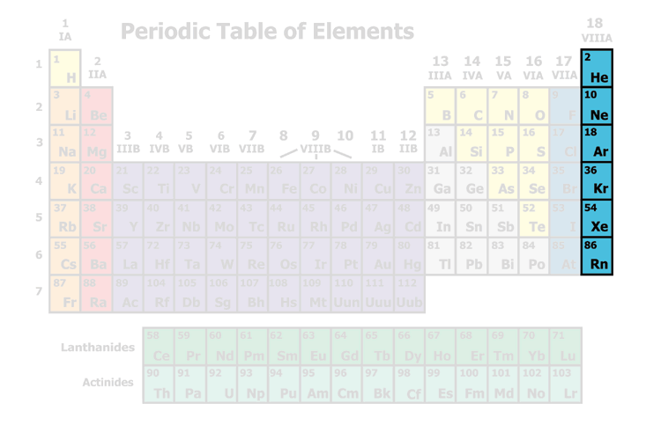
Noble Gases
Unreactive
Gases at room temperature

Slide 24
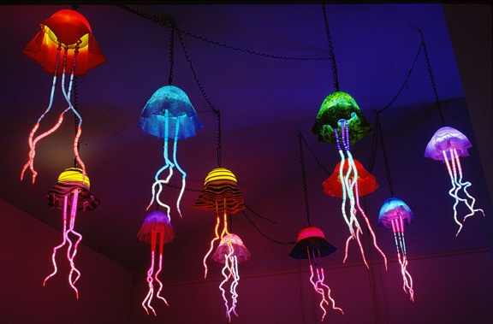
Jellyfish lamps made with noble gases artist- Eric Ehlenberger

Slide 25
Colors Noble Gases produce in lamp tubes:
Ne (Neon): orange-red
Hg (Mercury): light blue
Ar (Argon): pale lavender
He (Helium): pale peach
Kr (Krypton): pale silver
Xe (Xenon): pale, deep blue

Slide 26
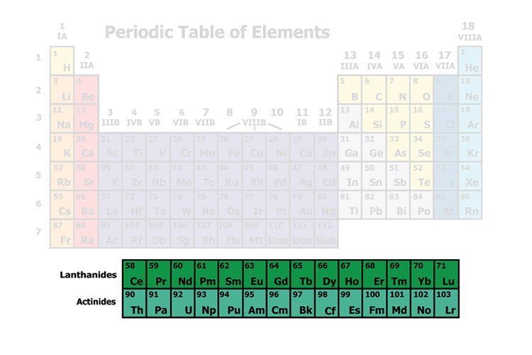
Lanthanide Series
Actinide Series

