Slide 1
Energy -- In Chemical Processes

Slide 2
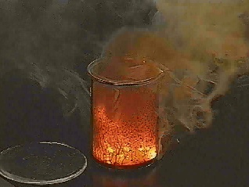
Energy
Energy - The ability to do work or cause a change
Joule – The SI unit of energy

Slide 3
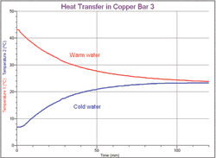
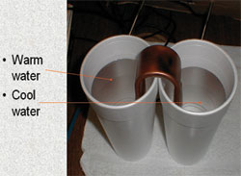
Heat Transfer
Heat – the energy transferred from an object at high temperature to and object at lower temperature.

Slide 4
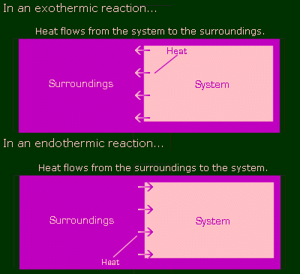
The Universe
System- the part you are investigating
Surroundings-the rest of the universe

Slide 5
Law of Conservation of Energy
Energy can’t be created or destroyed
The energy of the universe is constant

Slide 6
Reaction Pathway
Shows the change in energy during a chemical reaction

Slide 7
Animation
http://www.kmacgill.com/table_of_documents.htm
Kinetic Energy - energy in motion (usually resulting from molecular collisions).
Potential Energy – the amount of energy an object contains but has not released yet.

Slide 8
Enthalpy and Entropy
Enthalpy – The heat content of a system (also referred to as “q”)
Entropy – the measure of the amount of disorder in a process. (example: the amount of random motion molecular particles display)

Slide 9
Exothermic
System releases energy
Heat flows out
Surroundings get hotter
q is negative
System
Surroundings
Energy

Slide 10
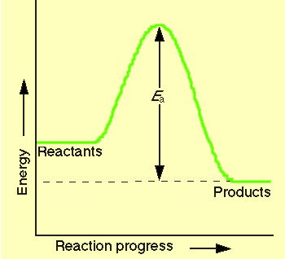
Exothermic Reaction
reaction that releases energy
products have lower PE than reactants
energy released
Ca_{(s)} + H₂O_{(l)} ➔ Ca(OH)_{2(s)} + H_{2(g)}

Slide 11
Endothermic
System absorbs energy
Heat flows in
Surroundings get cooler
q is positive
System
Surroundings
Energy

Slide 12
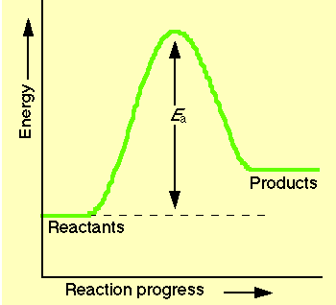
C. Endothermic Reaction
reaction that absorbs energy
reactants have lower PE than products
energy absorbed
NH₄Cl + Ba(OH)₂ + energy → NH₃ + H₂O + BaCl₂

Slide 13
Units of Energy
Energy is measured in Joules or calories
calorie is amount of heat to change 1 g of water by 1 °C
Food Calories are kilocalories
1Calorie = 1000 calories
1 cal = 4.184 J

Slide 14
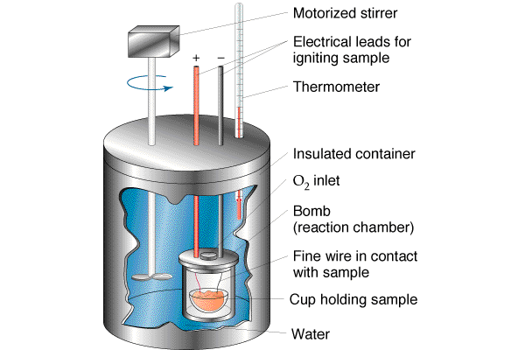
Calorimetry
A technique used to measure the heat energy generated in a chemical reaction
This technique used a device called a calorimeter.

Slide 15
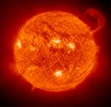
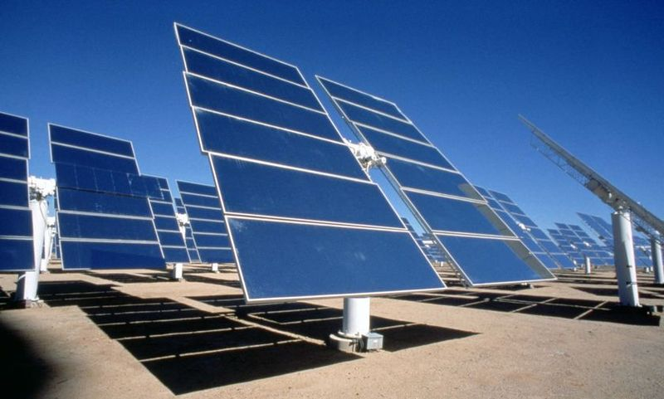
Solar Energy
Source of Energy from the Sun
Electromagnetic Radiation

Slide 16
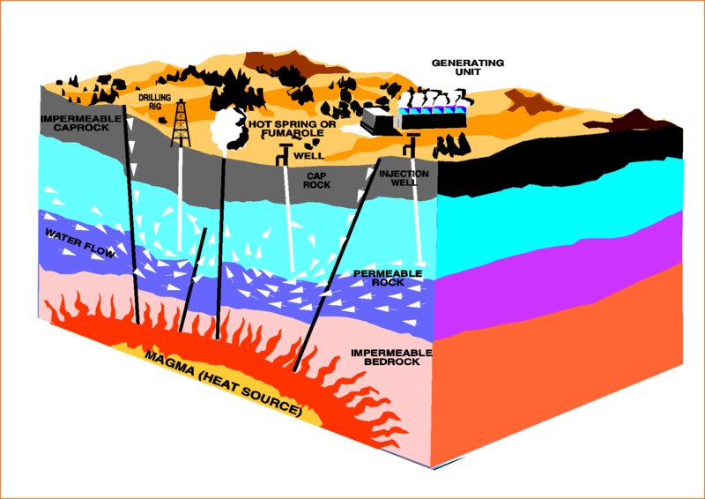
Geothermal Energy
Energy from the Molten Rock of the Earth

Slide 17
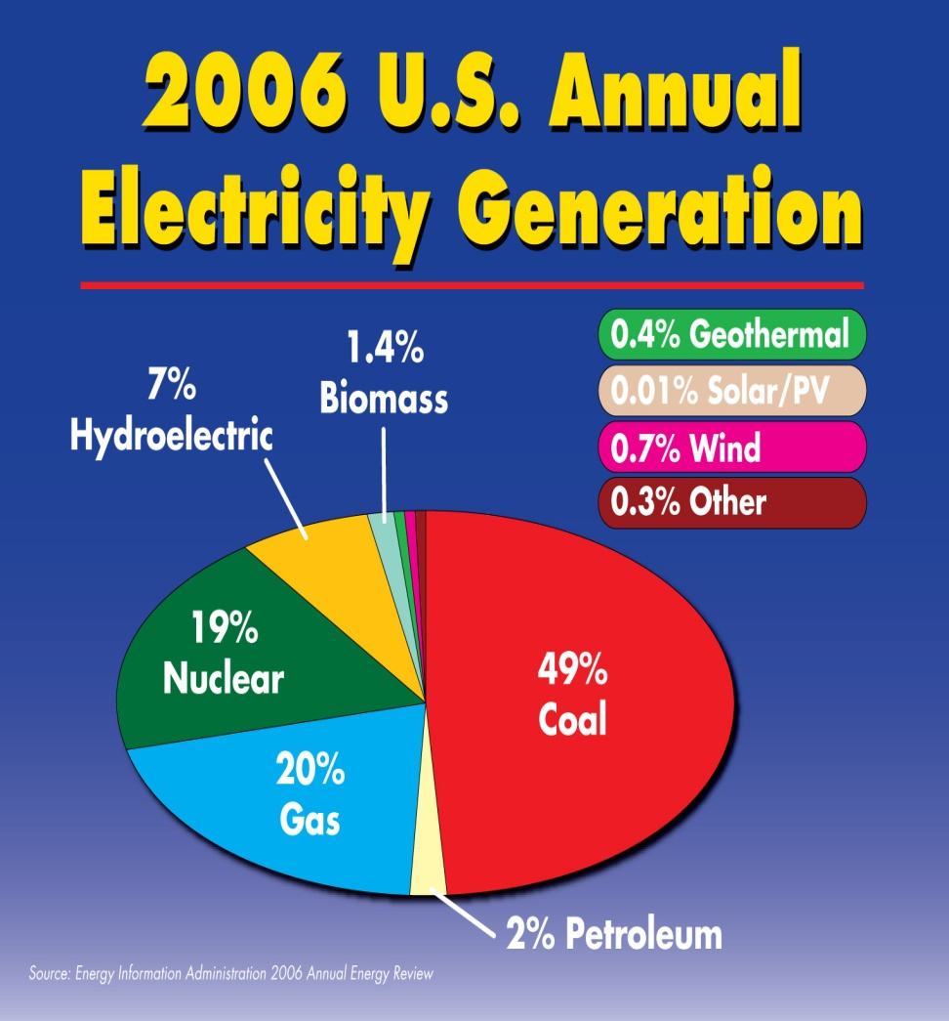
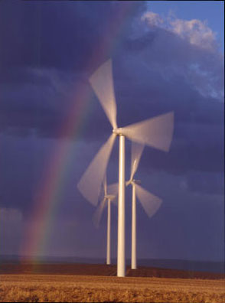
Wind Energy
Energy from the Wind used to Convert Mechanical Energy to Electrical Energy

Slide 18
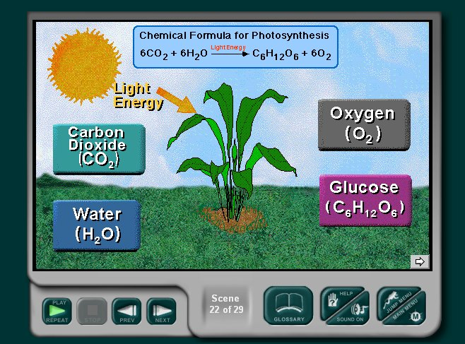
Photosynthesis
The Process used by certain organisms to capture Energy from the Sun

Slide 19
Careers in Energy
Productive for You
Productive for Earth
Solar Energy
Biomass Energy
Nuclear Energy
Wind Energy
Petroleum Energy
Geothermal Energy
Hydroelectric Energy
Coal Energy

