Slide 1
Matter and Energy Changes
Chapter 10 – Physical
Chapter 20 – Chemical

Slide 2
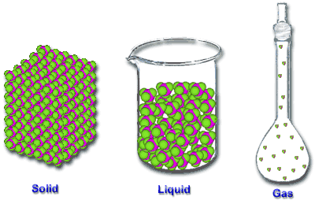
Physical Changes in Matter
Includes all changes of state (physical changes of a substance from one state to another)
change in a substance that doesn’t change the identity of the substance
Ex. grinding, cutting, melting, boiling

Slide 3
Kinetic Theory of Matter
Kinetic Theory - States that particles of matter are in constant, random motion.

Slide 4
Solid
definite volume
definite shape
atoms are packed together in fixed positions
strong attractive forces between atoms
only vibrate in place

Slide 5
Liquid
definite volume
indefinite shape
atoms are close together
atoms can overcome attractive forces to flow

Slide 6
Gases
indefinite volume
indefinite shape
atoms move very quickly
atoms are far apart
pretty weak attractive forces

Slide 7
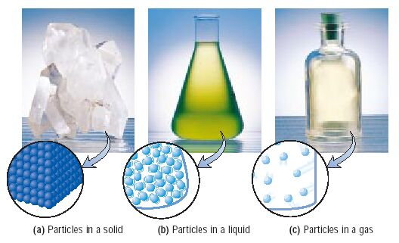
Three Phases of Matter

Slide 8
Changes of State
Evaporation – the process by which particles of a liquid form a gas by escaping from the liquid surface.
Sublimation – the process by which particles of a solid escape from its surface and form a gas.
Condensation – the process where gaseous particles come together, or condense, to form a liquid or at times a solid.

Slide 9
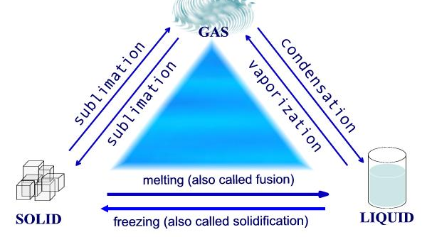
Changes of State

Slide 10
Changes of State
Boiling Point – The temperature at which a liquid changes to a gas.
Melting Point – The temperature at which a solid changes to a liquid.
Freezing Point – The temperature at which a liquid changes to a solid

Slide 11
Changes of State
Heat of Fusion – the amount of energy released as one kilogram (kg) of a substance solidifies at its freezing point.
Heat of Vaporization – the amount of energy absorbed when one kilogram (kg) of a liquid vaporizes at its normal boiling point.

Slide 12
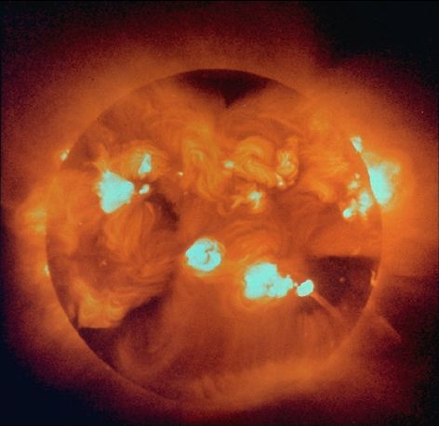
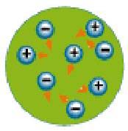
Plasma
Plasma is an ionized gas, occurring at high temperatures in which atoms lose their electrons.
Ex. the sun

Slide 13
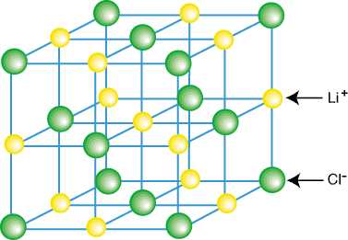
Representation of Components in a Crystalline Solid
Crystal Lattice: A 3-dimensional system of points designating the centers of components (atoms, ions, or molecules) that make up the substance

Slide 14
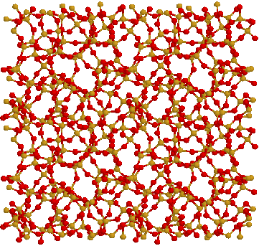
Types of Solids
Amorphous solids: considerable disorder in their structures (glass and plastic).

Slide 15
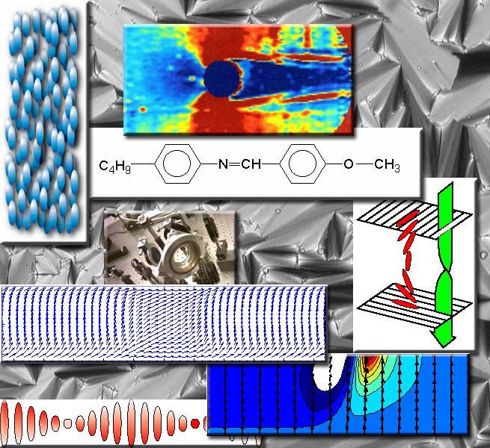
Liquid Crystals
A material that loses its rigid organization in only one or two dimensions when it melts.
Watches
Calculators
Laptop Computers

Slide 16
Energy Terminology
Energy: the capacity to do work.
Unit: Joules (J) Calorie (cal)
Temperature: the measure of the amount of heat in an object or space.
Specific Heat: the measure of the amount of heat needed to raise the temperature of one gram of a substance one degree Celsius.

Slide 17
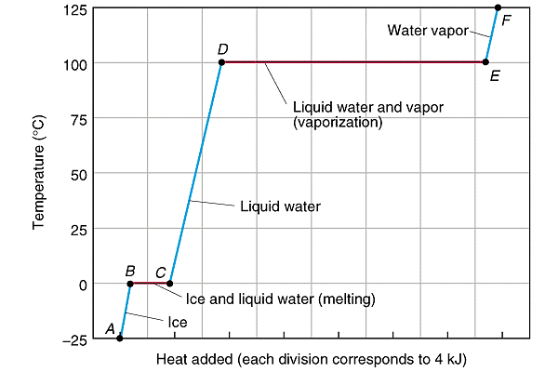
Heating Curve

Slide 18
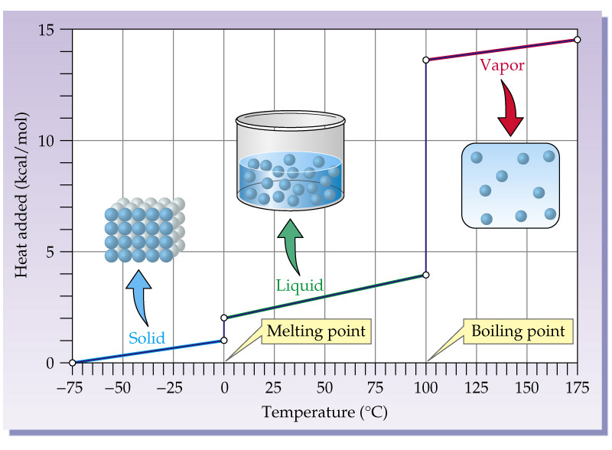
Heating Curve

